Slide 1
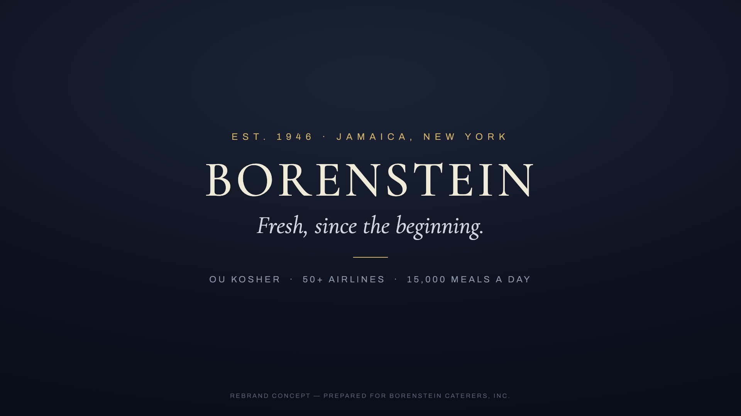
EST. 1946 · JAMAICA, NEW YORK
The film you asked for.
And the launch it deserves.
A digital launch worthy of Borenstein Caterers
FILM END CARD · STYLE I
Prepared by Integralink · July 2026

Slide 2
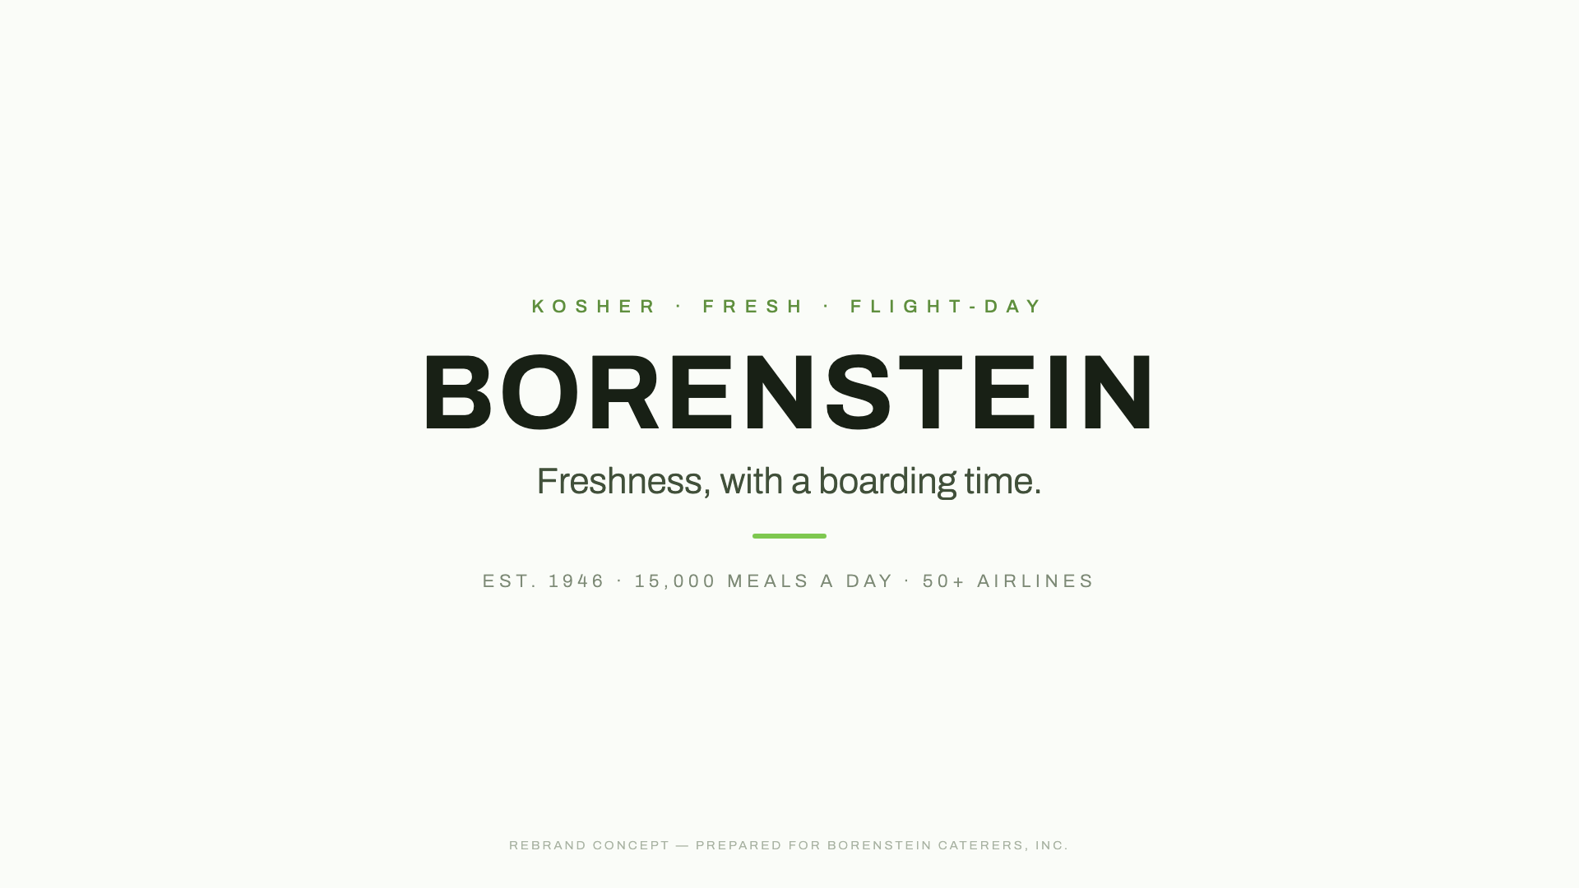

THE ASK
One film, 45–60 seconds.
The brief: the timeline — old planes to new — and the freshness the rebrand brings.
STYLE I · THE TIMELINE
STYLE II · FRESH CUT
STYLE III · THE LETTER
All three already produced in concept form — watch at borenstein-concepts.netlify.app
Integralink × Borenstein Caterers — concept & proposal
2

Slide 3
THE FILM
The film, finished
Your chosen style, finished master
60s + 45s + 15s cuts
Final voiceover + licensed music
Corrected & upgraded footage
$4,000 · $1,500 deposit to start · ships in 1 week
Integralink × Borenstein Caterers — concept & proposal
3

Slide 4
THE PIVOT
One question before you buy a film:
where does it send people?
bcelal.com — still says “coming soon”
3.7★, 70 reviews, unanswered
your only channel: LinkedIn
4

Slide 5
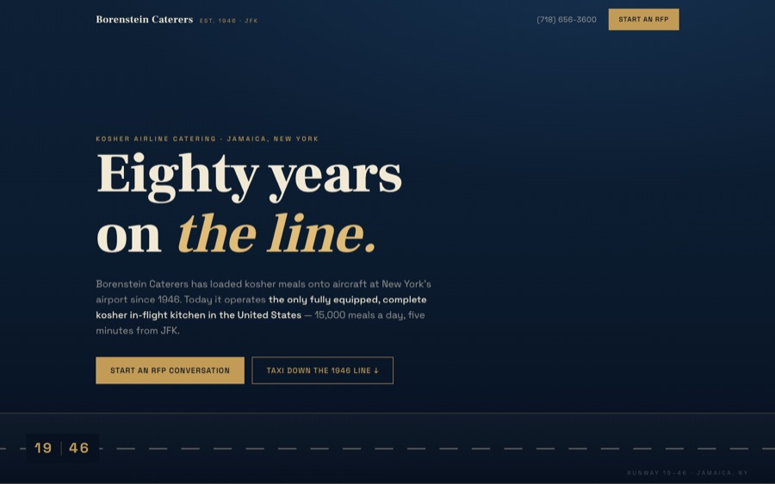
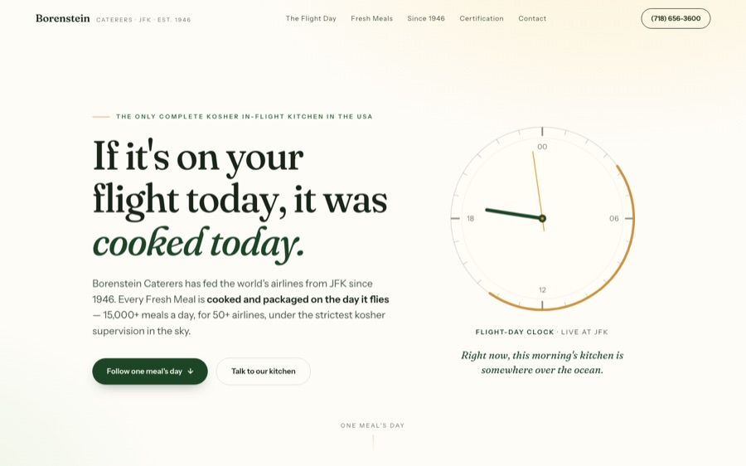
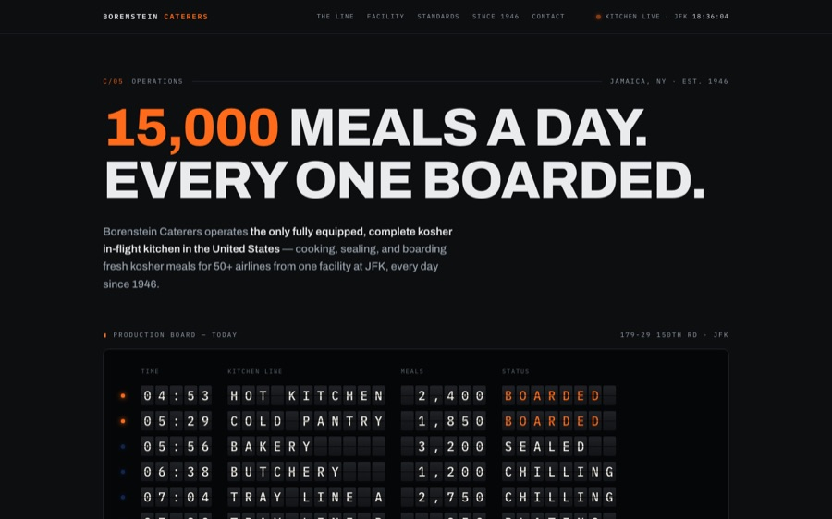
THE WEBSITE
Five answers, already built
CONCEPT A
CONCEPT B
CONCEPT C
Working websites, not mockups — your pick, sections mixable.
$8,500 · $2,500 deposit to start · live in 3 weeks
Integralink × Borenstein Caterers — concept & proposal
5

Slide 6
THE BUNDLE
Launch — the film and its home
The film, finished
The website, live
Your style — 60s / 45s / 15s cuts, final VO, licensed music.
Your pick of the five concepts — sections mixable.
Google Business overhaul
Analytics & go-live
The 3.7★ listing — claimed, completed, answered.
Tracking wired, domain pointed, launch handled.
Google Business overhaul & launch analytics included — $1,200+ value
$12,500 · $4,000 deposit to start · live in 3 weeks
Integralink × Borenstein Caterers — concept & proposal
6

Slide 7
80
THE MOMENT
In 2026, Borenstein turns eighty. Launch the rebrand on the anniversary — with the story told properly.
1946 – 2026
7

Slide 8
AFTER LAUNCH · MONTHLY
Grow
Lead capture with AI qualification & routing
Review responses drafted for approval
Proposal → e-sign → payment in one link
Tasting & booking scheduling
Monthly content — site + LinkedIn
$2,500 / month · first month when you start · cancel anytime
Integralink × Borenstein Caterers — concept & proposal
8

Slide 9
PHASE 3 · SCOPED PROJECTS
Scale
Kosher4U online ordering
Standing orders, subscriptions, delivery SMS.
Airline menu & spec portal
Client-facing menu rotations and dietary specs.
Operations AI
Meal-count reconciliation, invoicing, inventory reports.
from $18,000 + $1,500 / month · scoped per project
Integralink × Borenstein Caterers — concept & proposal
9

Slide 10
HOW PAYMENT WORKS
Payment terms
PATH | TO START | BALANCE
Film only ($4,000) | $1,500 deposit | $2,500 on final delivery
Website only ($8,500) | $2,500 deposit | $6,000 at go-live
Launch bundle ($12,500) | $4,000 deposit | $8,500 at go-live
Grow ($2,500/mo) | first month when you start | monthly, cancel anytime
Deposit and agreement arrive together in one link. No payment is due until you sign.
Integralink × Borenstein Caterers — concept & proposal
10

Slide 11
NEXT STEP
Three ways to start.
The film
Launch
The full program
Your style, finished — all three cuts
Film + website + Google, live in 3 weeks
Launch, then Grow month by month
$4,000 · $1,500 deposit to start
$12,500 · $4,000 deposit to start
$12,500 + $2,500 / month
1
Choose this week
2
Deposit to begin — agreement & payment arrive in one link
3
Live before the anniversary
Shlomo Ashvil · Integralink · integralink.ai
11

