Slide 1
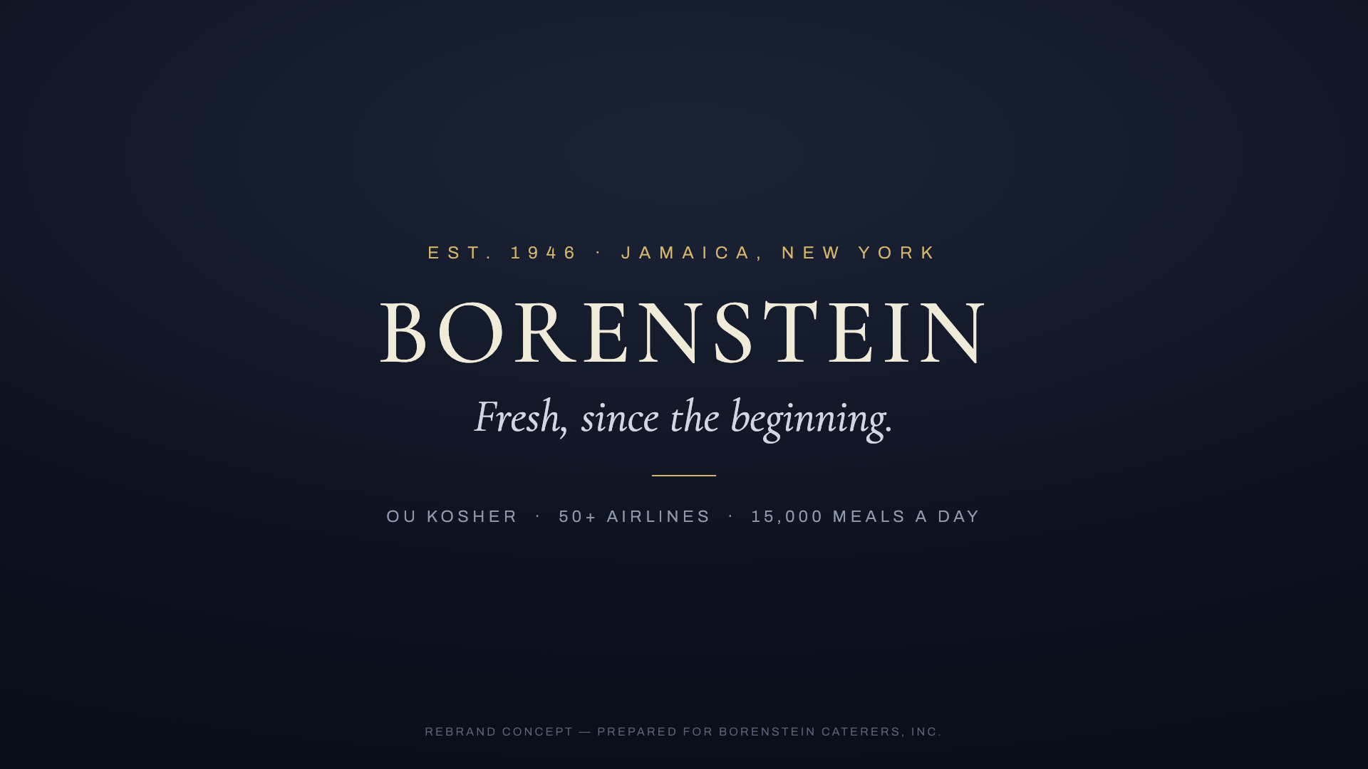
BORENSTEIN CATERERS · MONDAY REVIEW
Two ways forward.
Automation for everything beyond the airlines — and the film, standalone.
THE NEW BRAND · FILM END CARD
Prepared by Integralink · for Monday's review

Slide 2
PART ONE · LEAD AUTOMATION
The first reply wins the lead
Every institution, event, retail and Kosher4U inquiry begins at the website form — and the business goes to whoever answers first. Speed to lead is the whole game.
78%
21×
≤1 min
of customers buy from the company that responds first — industry research
more likely to qualify a lead answered in 5 minutes vs. 30 — MIT lead-response study
Borenstein’s automated first reply — nights, weekends, holidays
Integralink × Borenstein Caterers — proposal
2

Slide 3
PART ONE · WHAT THE LEAD RECEIVES
Sixty seconds after they hit submit
The shopping stops
“Hi, this is John from Borenstein Caterers — we received your request and will be calling you shortly.”
They came from a search. The first real reply ends it.
Your call is expected
“calling you shortly” turns a cold dial into a kept promise.
DELIVERED AUTOMATICALLY · UNDER ONE MINUTE · FROM BORENSTEIN’S OWN NUMBER
No lead goes cold
Friday night, Sunday morning — the reply is already there.
Integralink × Borenstein Caterers — proposal
3

Slide 4
PART ONE · DELIVERABLES
What gets built
Website form wired to instant SMS response
Automated email confirmation + internal routing to your team
Carrier registration under Borenstein's own brand — compliance handled
A log of every lead and every message sent
$3,500 · three-week build · $1,500 to start · balance at go-live
Integralink × Borenstein Caterers — proposal
4

Slide 5
PART ONE · LIVE DEMO
This is not a mockup.
A working version of your website form that texts back and emails in seconds — built on the new Borenstein brand.
LIVE DEMO
borenstein-demo.pages.dev
Open it in the meeting — submit the form, watch the text and the email arrive.
Integralink × Borenstein Caterers — proposal
5

Slide 6
PART ONE · TIMELINE
Three weeks, start to handoff
WEEK 1
WEEKS 2–3
Carrier registration filed
Texting live on carrier approval
Form + email automation live
Lead log
Internal routing
Tuning + handoff
Carrier approval of Borenstein's own brand typically lands in weeks 1–3 — everything else doesn't wait for it.
Integralink × Borenstein Caterers — proposal
6

Slide 7
PART TWO · THE FILM, STANDALONE
The film, finished to final approval
The 2-minute history presentation, taken from concept to a finished master.
Chosen version, narrator & score
Your pick of the concepts — recorded, scored and mixed to final.
Revision rounds
Structured feedback passes until the film is approved.
Full-resolution master + cutdowns
The finished film, plus shorter cuts for web and social.
$1,500 · $750 to start · balance on approval of the final master
Integralink × Borenstein Caterers — proposal
7

Slide 8
NEXT STEP
Approve today — live in three weeks.
1
2
3
Approve part one, part two, or both
Deposit arrives with the agreement in one link
Carrier filing + build start this week
Shlomo Ashvil · Integralink · integralink.ai
8

