Slide 1
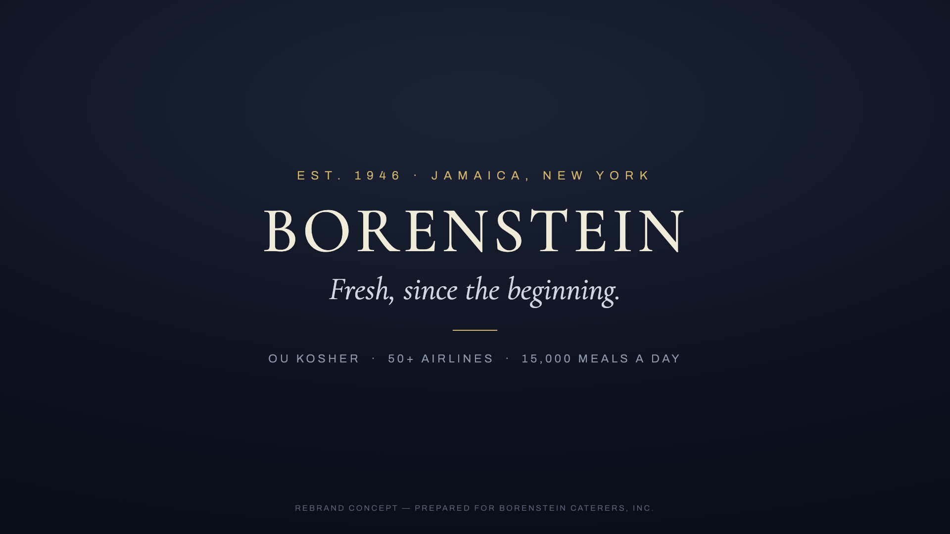
INTEGRALINK × BORENSTEIN CATERERS
The Catalog
Everything Integralink can build for Borenstein — by funnel stage
Companion to the launch offer · prices are per-item if bought à la carte
12
CATALOG ITEMS · 4 STAGES
From the Borenstein ad films — live at borenstein-concepts.netlify.app

Slide 2
THE MAP
How to read this catalog
I
II
III
IV
AWARENESS
CONSIDERATION
CONVERSION
RETENTION & OPERATIONS
Website & landing pages
Google Business & reviews
Content + 80th campaign
Menu & tasting portal
One-pager generator
Lead capture & AI routing
Proposal → sign → pay
Tasting scheduling
Kosher4U online ordering
Order status & reorders
Back-office AI
Executive dashboard
Every item ships independently. The launch offer bundles the essentials.
Integralink × Borenstein Caterers — concept & proposal
2

Slide 3
STAGE I OF IV
I
Awareness
Be found, look like you deserve to be.
In this stage: Website & audience landing pages · Google Business & review engine · Content engine + 80th-anniversary campaign
3

Slide 4
I · AWARENESS
Be found, look like you deserve to be
Website & audience landing pages
Google Business & review engine
Content engine + 80th campaign
The finished site, assembled from the five live concepts — with dedicated pages for airlines, cruise, institutions, and consumers.
Own the listing. AI-drafted review responses sent for your approval, plus local SEO schema.
Monthly flight-kitchen stories and a LinkedIn cadence, plus an anniversary microsite and press kit for 2026.
SOLVES
SOLVES
SOLVES
Invisibility. bcelal.com still says “coming soon.”
3.7★ and 70 reviews, all unanswered.
A story running since 1946 that no one is telling.
SHIPS IN 3 weeks
SHIPS IN 1 week setup
SHIPS IN ongoing
$8,500
$1,200 + $400/mo
$900/mo · campaign $3,500
Integralink × Borenstein Caterers — concept & proposal
4

Slide 5
STAGE II OF IV
II
Consideration
Make evaluating you effortless.
In this stage: Menu & tasting portal · Capabilities one-pager generator · Lead capture & AI routing
5

Slide 6
II · CONSIDERATION
Make evaluating you effortless
Menu & tasting portal
Capabilities one-pager generator
Lead capture & AI routing
A private, airline-facing portal: menu rotations, dietary matrices, and imagery buyers can browse on their own.
A branded PDF generated per prospect: certifications, HACCP/OU documentation, and capacity figures.
Site forms that send an instant, qualified reply and route each inquiry to the right desk — airline or event.
SOLVES
SOLVES
SOLVES
Buyers can’t evaluate what they can’t see.
Every RFP response starting from scratch.
Inquiries that wait. Leads that go cold.
SHIPS IN 2 weeks
SHIPS IN 1 week
SHIPS IN 1 week
$4,500
$2,500
$1,800 + $300/mo
Integralink × Borenstein Caterers — concept & proposal
6

Slide 7
STAGE III OF IV
III
Conversion
From quote to signed to paid, one link.
In this stage: Proposal → e-sign → payment pipeline · Tasting & meeting scheduling · Kosher4U online ordering
7

Slide 8
III · CONVERSION
From quote to signed to paid, one link
THE SLEEPER
Proposal → e-sign → payment pipeline
Tasting & meeting scheduling
Kosher4U online ordering
Quotes become a single link: review, sign, and pay in one place, built on Documenso and Stripe.
Self-serve booking embedded on the site — tastings and sales meetings land on the calendar by themselves.
Standing weekly office and school orders, subscriptions, and delivery-day SMS for the grab-and-go line.
SOLVES
SOLVES
SOLVES
The weeks between “yes” and paid.
Phone tag to book a tasting.
Retail revenue capped at the counter.
SHIPS IN 2 weeks
SHIPS IN 3 days
SHIPS IN 6–8 weeks
$3,500
$1,200
from $18,000 + $1,500/mo
Integralink × Borenstein Caterers — concept & proposal
8

Slide 9
STAGE IV OF IV
IV
Retention & Operations
Where the margin lives.
In this stage: Order status & reorder automation · Back-office AI · Executive dashboard
9

Slide 10
IV · RETENTION & OPERATIONS
Where the margin lives
Order status & reorder automation
Back-office AI
Executive dashboard
“Where’s my order,” one-tap reorders, and delivery updates over SMS or WhatsApp — handled without a phone call.
Airline meal-count reconciliation, invoice processing, and waste and inventory reports — one workflow at a time.
Daily production, the sales funnel, and review sentiment on a single page — for a 15,000-meals-a-day operation.
SOLVES
SOLVES
SOLVES
Staff hours lost to status calls.
Margin leaking through manual admin.
Running the business on instinct.
SHIPS IN 2 weeks
SHIPS IN scoped
SHIPS IN 2 weeks
$2,500
from $6,000 per workflow
$3,000
Integralink × Borenstein Caterers — concept & proposal
10

Slide 11
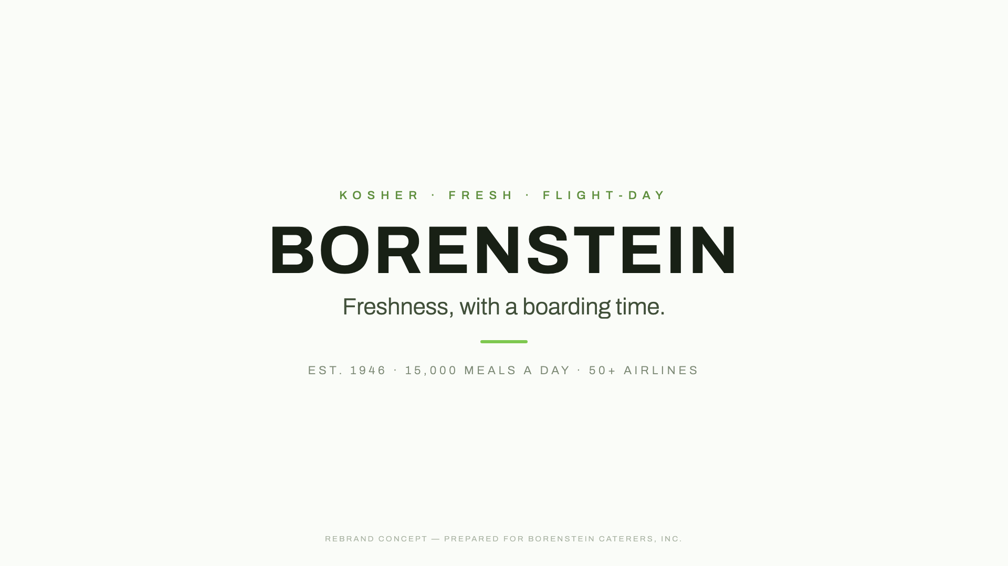

ANNEX
Media annex — films & imagery
The brand film, finished — $4,000
One finished master: 60s + 45s cuts, final VO, licensed music — in the style you choose below.
Film style I — the signature end card
Film style II — the bright cut
Film style III — the letter
ADDITIONAL CUTS (15S / 30S SOCIALS) & PHOTOGRAPHY DIRECTION — PER PIECE, FROM $1,500
All three styles are watchable now at borenstein-concepts.netlify.app
Integralink × Borenstein Caterers — concept & proposal
11

Slide 12
À LA CARTE
Price index
 | ITEM | ONE-TIME | MONTHLY
I | Website & audience landing pages | $8,500 | —
 | Google Business & review engine | $1,200 | $400
 | Content engine + 80th campaign | $3,500 campaign | $900
II | Menu & tasting portal | $4,500 | —
 | Capabilities one-pager generator | $2,500 | —
 | Lead capture & AI routing | $1,800 | $300
III | Proposal → e-sign → payment pipeline | $3,500 | —
 | Tasting & meeting scheduling | $1,200 | —
 | Kosher4U online ordering | from $18,000 | $1,500
IV | Order status & reorder automation | $2,500 | —
 | Back-office AI (per workflow) | from $6,000 | —
 | Executive dashboard | $3,000 | —
M | Brand film, finished (60s + 45s masters) | $4,000 | —
BUNDLES
Launch
$12,500 one-time
Grow
$2,500 / month
Scale
scoped per project
See the offer deck for what each bundle includes.
Prices hold 30 days.
Shlomo Ashvil · Integralink
integralink.ai
Bundles: Launch $12,500 · Grow $2,500/mo · Scale scoped — see offer deck. Prices hold 30 days.
12

